Slide 1
Distributed Computing* on HTCondor
Matthew Carter, matthew.carter@liverpool.ac.uk
Cdt in Distributed algorithms
*With a focus on high throughput computing

Slide 2
Overview
What is Distributed Computing?
High Throughput Computing
HTCondor
Asynchronous Algorithms on HTCondor
Synchronous Algorithms on HTCondor

Slide 3
What is Distributed Computing? Overview of Distributed Computing
“A distributed system is one which the failure of a computer you didn’t even know existed can render your own computer unusable” – Leslie Lamport

Slide 4
What is Distributed Computing? Overview of Distributed Computing
Distributed computing refers to the use of distributed systems to solve a computational problem.
A distributed system is a collection of independent computers, interconnected via a network, which can communicate with one another via message passing.
A distributed system may look like:
A collection of computers working to solve a common goal, such as solving a large computational problem (e.g. weather simulation). In this case, the resources of the system are coordinated to solve the common goal.
A shared collection of resources which are each tasked with solving a different goal (e.g. serving users of a website different content). In this case, the shared resources must be coordinated to serve each user’s needs.
It consists of multiple nodes (computers, phones, cars, …) communicating over (possibly multiple and geographically separated) network interfaces (routers, cell towers, satellites, …)

Slide 5
What is Distributed Computing? Parallel versus Distributed Computing
The distinction between distributed computing and parallel computing is blurry
Parallel computing can be viewed as a form of distributed computing
We can draw the following distinction:
Parallel computing refers to utilising multiple processors or cores that are in a single node or multiple, tightly-coupled nodes (e.g. nodes in a high-performance computer)
Distributed computing refers to utilising multiple independent nodes that are connected via a loosely-coupled network (e.g. people's personal computers in Liverpool)
We can run parallel algorithms on distributed computing architectures, but cannot expect the same scaling in computational time

Slide 6
What is Distributed Computing? Architectures
When thinking of distributed systems, we typically think of the following architectures:
Client-server: Clients submit a request to a server; the server then responds to the client’s request. For example, a user requesting their balance from a banking app.
Peer-to-peer: All responsibilities are divided amongst all machines (referred to as peers) within the network. Peers act as both client and server, e.g. Bittorrent.
However, more relevant architectures for distributed algorithms include:
Loose Coupling: Components of the distributed system are loosely coupled, often interacting through message passing or remote procedure calls, e.g. grid computing, opportunistic networks. This allows for flexibility and independence between components of the system (and is the main focus of this lecture!)
Tight Coupling: Components of the distributed system have tight dependencies on one another and share resources more closely, e.g. high-performance computing clusters.

Slide 7
What is Distributed Computing? Benefits
Economics
Distributed systems allow the pooling of resources (which may be pre-existing, e.g. idle campus computers)
Scalability
Distributed systems can easily scale by adding additional nodes to the system
Fault Tolerance
Distributed systems can be designed to be fault tolerant: if one node fails, the computation can be rescheduled to an additional node
Performance
Distributed systems can handle larger amounts of data and potentially reduce the run-time of computationally intense tasks

Slide 8
What is Distributed Computing? Drawbacks
Complexity
Designing, implementing and maintaining distributed systems can quickly become complex. Considerations must be made to account for heterogenous resources, reduce communication overhead and ensure fault tolerance within the network.
Multiple Points of Failure
Several participating computers or network links may fail at any given time.
Consistency and Coordination
We must ensure that data are consistent across participating nodes (e.g. through consensus algorithms) and that tasks are effectively coordinated to not waste compute power.
Communication Overhead
Distributed systems may be constructed of nodes which are separated by large geographic distances, which results in a high overhead due to latency. Communication should therefore be avoided unless absolutely necessary.

Slide 9
What is Distributed Computing? Examples of Distributed Computing
Telecommunications networks such as telephone networks, cellular networks and the internet
Network applications such as the World Wide Web, MMO’s and distributed databases / file systems
Parallel computation including cluster computing, grid computing, cloud computing, opportunistic computing, …

Slide 10
High Throughput Computing Overview
A form of distributed computing which is focused on maximising throughput by executing multiple tasks concurrently
Unlike HPC, HTC is focused on multiple task execution over single-task speed optimisation (focuses on task parallelism and not domain decomposition)
Tries to optimise the utilisation of resources and minimise wait times
Applied to numerous problems including:
Genomics
Drug Discovery
Climate Modelling
Astrophysics
Common HTC middleware include HTCondor and BOINC

Slide 11
High Throughput Computing Success Stories: SETI@HOME
SETI is the Search for Extraterrestrial Intelligence, based at UC Berkley
Utilises BOINC which is a volunteer computing platform
When idle, SETI@HOME will utilise individual’s computers to analyse radio telescope data
At its peak, SETI@HOME had the ability to compute over 668 teraFLOPS
Frontier at Oakridge performs 1.19 exaFLOPS which is 1,783 times greater
ARCHER2 at Edingburgh performs 28 petaFLOPS which is 41 times greater

Slide 12
High Throughput Computing Success Stories: Folding@Home
Utilises a mix of GPU, CPU and Raspberry Pi compute
Helps scientists discover new drugs for a number of diseases
Created by the University of Pennsylvania, utilises volunteer computing via BOINC
Popularity grew throughout the COVID pandemic, Folding@Home compute power reached 768 petaFLOPS
Since COVID, its popularity decreased and is currently sat at 28 petaFLOPS

Slide 13
HTCondor
HTCondor is a high-throughput computing (HTC) software framework designed to manage distributed computing resources efficiently
Developed by the Center for High Throughput Computing at the University of Wisconsin-Madison
Enables users to harness idle computing power from desktops, clusters, and grids to execute computational tasks
Features job scheduling, resource management, and fault tolerance capabilities
Supports various workload types, including batch jobs, parameter sweeps, and MPI applications

Slide 14
University of Liverpool HTCondor Pool Overview
Makes use of classroom PCs located in teaching and learning centres across campus
The size of the pool varies widely depending on the time of the day and year, it’s most populated outside of teaching hours and term times
At its peak, the pool allows for a maximum of 1,900 jobs running concurrently
All of the machines in the HTCondor pool run MWS and have the following specifications:
Intel Core-i5 (six core) processor @ 3GHz
16GB of memory
330GB of disk space
Machines are configured to run one job per core

Slide 15
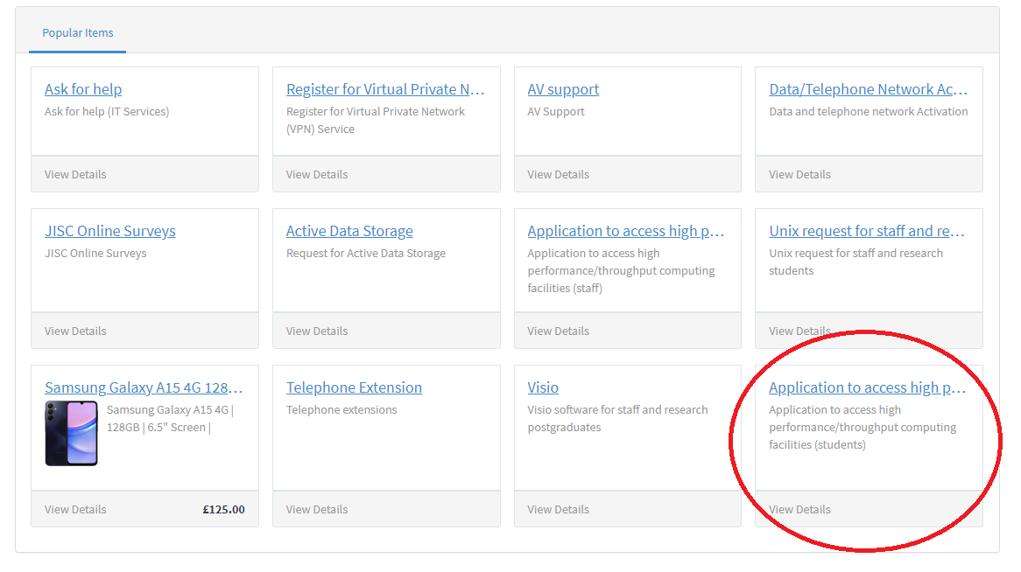
University of Liverpool HTCondor Pool Registration

Slide 16
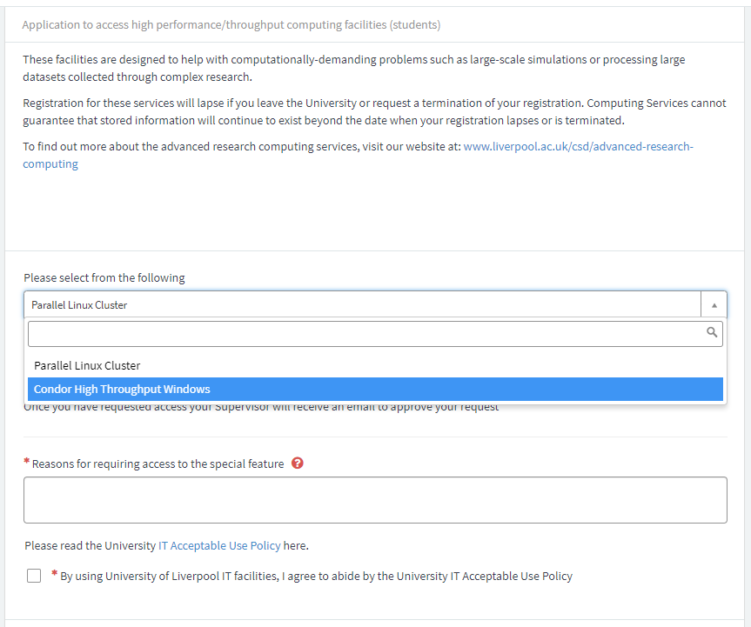
University of Liverpool HTCondor Pool Registration

Slide 17
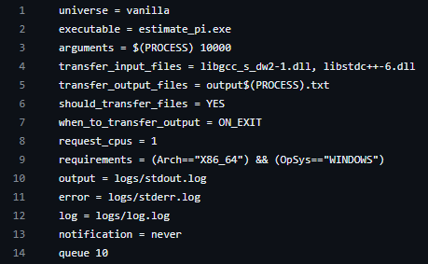
University of Liverpool HTCondor Pool Job Descriptions
General job submission

Slide 18
University of Liverpool HTCondor Pool Simplified job submission
A number of tools have been developed on the Universities pool to make job submission simpler
mws_submit: generates a full job description from a simplified job description
matlab_submit: run matlab applications on the Condor pool, handles indexing of input and output files
python_submit: run python applications on the Condor pool, handles indexing of input and output files
Interfaces also exist for C/C++ and Fortran applications
More information at http://condor.liv.ac.uk/tools/

Slide 19
University of Liverpool HTCondor Pool Useful Commands
condor_submit: submit jobs to the scheduler (note, if using the alternative Python or MATLAB interfaces you must use python_submit or matlab_submit)
condor_q: see what jobs are in the queue and their status
condor_rm: remove a job from the queue
condor_status: list the status of machines in the condor pool

Slide 20
University of Liverpool HTCondor Pool Some Drawbacks
Computers in the pool are configured to run one job per core, which reduces the amount of available memory (though there are ways to get around this)
Computers in the pool are Window’s based, so we cannot leverage containers like docker
As the pool is Window’s based, we are limited to the “Vanilla” HTCondor Universe
In this universe, it is not possible for nodes to communicate with one another
Queue time for jobs can be high

Slide 21
Pleasingly Parallel Algorithms Overview
Often referred to as embarrassingly parallel
A form of computation that can be divided into a large number of independent tasks that require little to no communication or coordination between them
Characteristics
Independence
No data sharing
Scalability
Examples include
Monte Carlo simulations (e.g. https://github.com/mjcarter95/UoL-HTCondor-101/tree/master/python_applications)
Running multiple MCMC chains

Slide 22
Pleasingly Parallel Algorithms What if my application isn’t?!
A wide range of algorithms are not pleasingly parallel and require a lot of communication and synchronisation (e.g. SMC samplers)
We may still want to capitalise on HTCondor to make use of spare compute
Careful consideration must be taken
How do we effectively coordinate tasks?
How do we account for heterogeneity?
How do we effectively utilise the job scheduler?
How do we communicate?
How do we reduce communication?

Slide 23
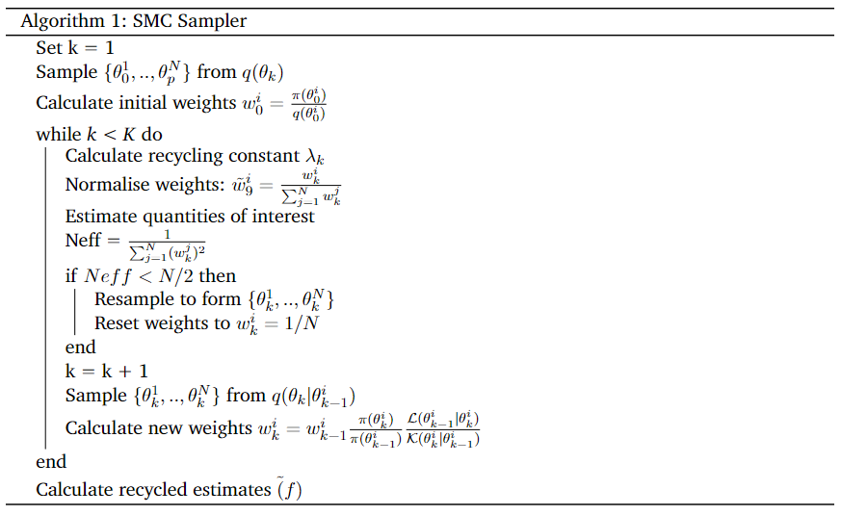
Synchronous Algorithms SMC Samplers

Slide 24
Synchronous Algorithms Overview
Participating nodes proceed in lockstep
Each process waits for specific synchronisation points before proceeding to the next step
Synchronous algorithms are often simple to design and reason about
Synchronous algorithms may be limited in scalability as they do not effectively account for heterogeneity in distributed systems

Slide 25
Synchronous Algorithms Synchronous SMC Samplers
Leverage coordinator-follower (commonly referred to as “master-worker”) paradigm
At each iteration, the coordinator requests N followers via the Condor scheduler
Followers propagate samples forward one iteration calculates their new weights, then sends the new samples and weights to the coorindator
The coordinator then aggregates the weights and samples and performs key operations of the smc sampler
This is very slow!!

Slide 26
Asynchronous Algorithms Overview
Asynchronous algorithms allow nodes to progress through their computations indepdently
Nodes communicate and coordinate asynchronously and so do not need to communicate with each other at predefined sychronisation points
Asynchronous algorithms are therefore more flexible and can provide better scalability
However, designing asynchronous algorithms is difficult and sometimes impossible
We may therefore opt for something which is “pseudo-asynchronous” and relaxes the communication overheads of an algorithm by reducing the number of synchronisation points

Slide 27
Asynchronous Algorithms Asynchronous SMC Samplers
Run N independent SMC samplers
Aggregate recycled estimates after all SMC samplers have finished
Not a very satisfying solution?
Does not fully account for heterogeneity in the network
One SMC sampler may finish executing before others

Slide 28
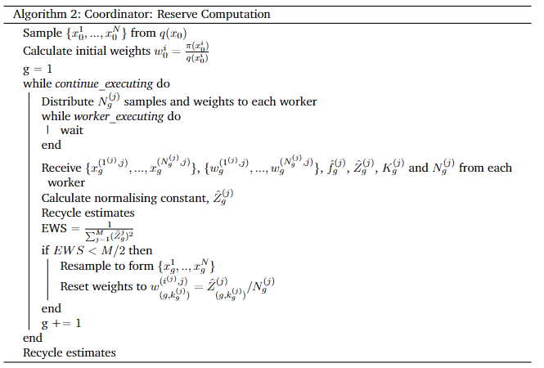
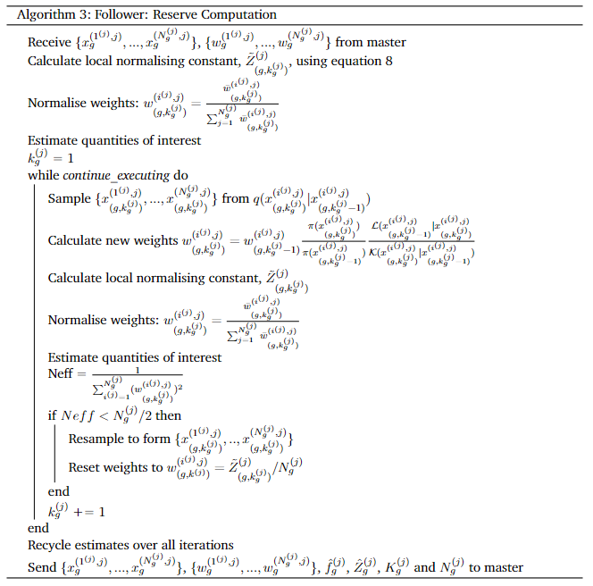
Asynchronous Algorithms Pseudo-asynchronous SMC Samplers

Slide 29
Communicating in HTCondor
In the Vanilla HTCondor Universe, nodes cannot communicate with one another
They can, however, send messages to an external server
We can use a database to facilitate communication!

Slide 30
Communicating in HTCondor
CondorCMF is a Python package that
Provides a Pythonic interface to scheduling and managing HTCondor jobs
Provides communication between nodes in a HTCondor pool via a MySQL database
Available at https://github.com/mjcarter95/CondorCMF
Example of requesting nodes in HTCondor and using them to add some numbers together
https://github.com/mjcarter95/CondorCMF/blob/main/examples/dbqueue/dbqueue_addition.py

